Slide 1
Smart Shopping Trolley
Final year project by Kostadin kolev

Slide 2
Why is the project important?
More than just a shopping list app
The list of shops which will be shown to the user is generated using his/her current location
SmartShopping suggests to its users items which they might find worth buying
Benefits from the application
Shopping will be easier
New functionalities can be implemented
SmartShopping is scalable
Personal benefits

Slide 3
Requirements
Requirement ID: 1
Description: Users must be able to log in the systems. Users` credentials will be checked and compared to the database during login.
Rationale: By implementing login functionalities it is assured that only registered users can use the software. Also it provides a certain level of security against unauthorized access.
Fit-criterion: Unit test cases which will be launched during testing. Various attempts will be made to access the system. The users who do not have credentials in the system will not be able to gain access.
Dependency: 1DB
Satisfaction level: 5
Dissatisfaction level: 5
Priority: High
Volere approach used to define requirements
Offers the ability to reprioritise requirements
Easy way to see which requirements should be implemented first
Traceability
The importance of the requirement can be seen in a clear way

Slide 4
Tools
SmartShopping`s server is written in PHP
Easier for creation than a Java server
Drivers do not need to be installed
Gain skills in PHP
JSON used for encoding
Easier for understanding than XML
Widely used in industry
Items bought by the user are stored in a SQLite database
Android supports SQLite
Main database will not be pre-occupied by items bought by the users

Slide 5
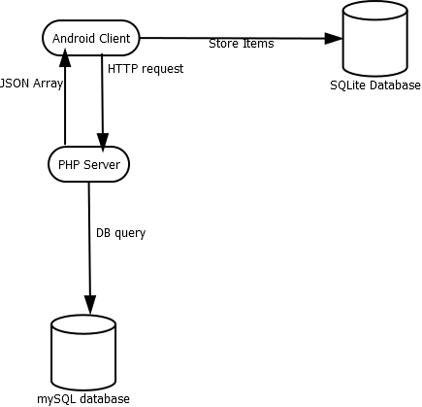
Client-server software architecture
Connection between the client and the server is achieved by sending/receiving HTTP requests
Connection between server and the databased is achieved by sending queries
Data received by the client is encoded in JSON
Special classes in the Android app care for presenting the information in the right way

Slide 6
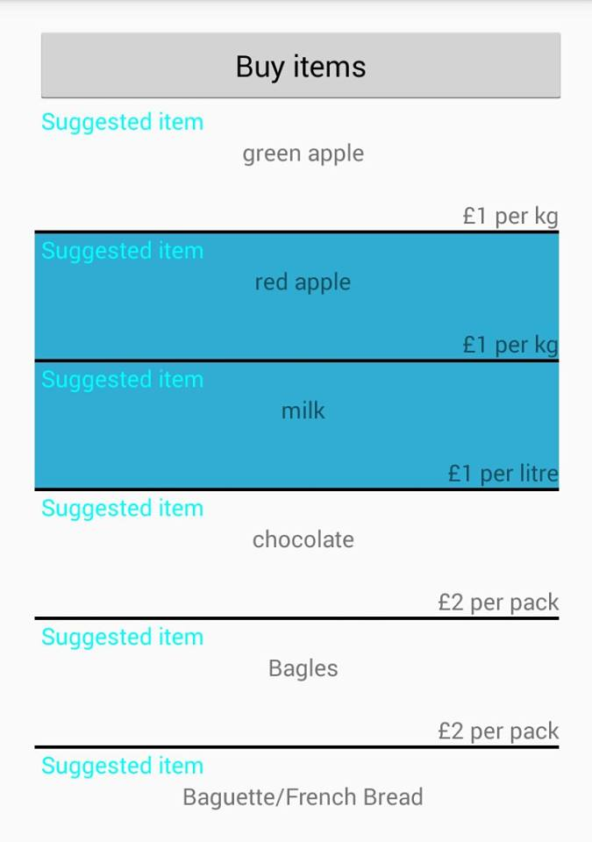
The client
Android application
Connects to the server via HTTP requests
Receives the data needed encoded in JSON format
Helper classes used to parse the data and populate the pages seen by the user
Bought items stored in an internal database

Slide 7
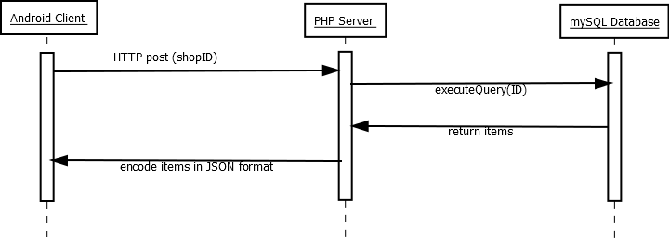
The server
Written in PHP
Receives calls from the client
The server handles the calls and queries the database for the needed information
Returns the requested information to the client

Slide 8
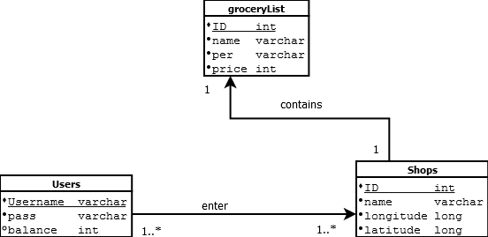
The database
“Central” MySQL database which stores the important information
Users
Shops
Contents of shops
SQLite database which stores purchases of the user
Product
Number of times that the item has been bought

Slide 9
Problems and solutions
Problems
The functionality of the system is highly dependent to the state of the server
Same host for database and server
Limit to the number of connections to the database
Solutions
Creation of backup servers
Creation of database servers
Different database servers storing different part of the data

Slide 10
Thank you for your attention!

